Slide 1
Part-of-Speech Tagging and Hidden Markov Models
CS 162: Natural Language Processing
Nanyun (Violet) Peng
Course website: https://vnpeng.net/cs162_win24.html
syllabus,
announcements,
slides,
homeworks
1

Slide 2
Important Announcements
Assignment 3 will be released today.
It dues on March 11th, 11:59pm
It is slightly lighter compared to other HW considering the course project efforts.
We will have weekly submission window for the course project.
You can have three attempts at each submission period
There is no penalty if you didn’t use all your attempts, but it’s in general helpful if you manage to test more times.

Slide 3
Midterm Feedback
We’re reached 115/130 responses, way over 75%. Thank you for sending in your feedback!
As promised, everyone got +5% for their midterm exam.
Summary of constructive feedbacks:
Tone down the calculations for exams (underestimated the time needed to do the actual calculation).
More examples in the slides of the actual computations like the exam.
An outline for each lecture.
Exam and homework be proofread better.
More office hours – I will offer additional office hours on Fridays

Slide 4
Our Words
Homeworks and midterms are designed in good faith. Homeworks are pretty comparable to similar NLP courses out their. We did realize that the midterm was too computational heavy with the actual example setup, which we will improve.
We hope to see more in-person participations in lectures, discussion sessions, and office hours.
This is the first time we operate under the 80/1 TA/student ratio. We encourage students replying to Piazza questions to help each other out, and get the bonus grade bump.

Slide 5
Outline
The Part-of-Speech (POS) tagging task.
Sequence Tagging problems
Hidden Markov Model (HMM)
The inference problem
The Viterbi algorithm

Slide 6
Part-of-Speech Tagging

Slide 7
What are parts of speech?
Syntactic labels/types for words.
Nouns, Pronouns, Proper Nouns,
woman she Lisa
Verbs, Auxiliaries,
run is/am/are
Adjectives, Adverbs
brilliant brilliantly
Prepositions, Conjunctions,
from because
Determiners, Particles
the to
Numerals, Symbols,
two +
Interjections, etc.
ahh
See e.g. https://universaldependencies.org/u/pos/

Slide 8
Part-Of-Speech Tagging
Annotate each word in a sentence with a part-of-speech marker.
Lowest level of syntactic analysis.
Cannot rely on a dictionary to look up the correct POS tags.
Due to ambiguity
and unknown words
John saw the saw and decided to take it to the table.
NNP VBD DT NN CC VBD TO VB PRP IN DT NN

Slide 9
Why Part-Of-Speech Tagging?
POS tagging is one of the first steps in the NLP pipeline (right after tokenization, segmentation).
Useful for subsequent syntactic parsing, word sense disambiguation, and information extraction.
Note: Although many neural network models no longer rely on POS tagging, some still use them as features/embeddings.
It is still important to understand what makes POS tagging difficult (or easy), and how the basic models and algorithms work.
Notes:
IE: Finding names, dates, relations, etc.

Slide 10
Ambiguity in POS Tagging
“Like” can be a verb or a preposition
I like/VBP candy.
Time flies like/IN an arrow.
“Around” can be a preposition, particle, or adverb
I bought it at the shop around/IN the corner.
I never got around/RP to getting a car.
A new Prius costs around/RB $25K.
“Back” can be an adjective, noun, particle, or verb.
The back door (adjective)
On my back (noun)
Win the voters back (particle)
Promised to back the bill (verb)

Slide 11
Ambiguity in POS Tagging
Time flies like an arrow.
NN VBZ IN DT NN
Fruit flies like a banana.
NN NN VBP DT NN

Slide 12
How Much Ambiguity is There?
Common POS ambiguities in English:
Noun—Verb: study, work, plug, seal, signal, stamp, wipe, mark…
Adjective—Verb: laughing, known, working, paid, functioning, running, used…
Noun—Adjective: normal, red, cardinal, coral, rose
A word is ambiguous if it has more than one POS
Most word types appear with only one POS tag….
Brown corpus with 87-tag set: 11.5% of word types are ambiguous
… but a large fraction of word tokens are ambiguous Original Brown corpus: 40% of tokens are ambiguous (why?)

Slide 13

POS Tagging Process
Average POS tagging disagreement amongst expert human judges for the Penn treebank was 3.5%
Current state-of-the-art model can already achieve this performance.
Baseline: Picking the most frequent tag for each specific word type gives about
93.7% if use model for unknown words for Penn Treebank tagset.
90% accuracy

Slide 14
POS Tagging Approaches
Rule-Based: Human crafted rules based on lexical and other linguistic knowledge.
Learning-Based: Trained on human annotated corpora like the Penn Treebank.
Statistical models: Hidden Markov Model (HMM), Maximum Entropy Markov Model (MEMM), Conditional Random Field (CRF)
Neural networks: Recurrent networks like Long Short Term Memory (LSTMs)
Or 1+2: Neural-CRF
Generally, learning-based approaches have been found to be more effective overall.

Slide 15
Sequence Tagging/Labeling Problem

Slide 16
Sequence Tagging Problem
Many NLP problems can viewed as sequence tagging/labeling.
Each token in a sequence is assigned a label.
Labels of tokens are dependent on the labels of other tokens in the sequence, particularly their neighbors.
Time flies like an arrow.
NN VBZ IN DT NN
Fruit flies like a banana.
NN NN VBP DT NN

Slide 17
Beyond Classification Learning
Standard classification problem assumes individual cases are disconnected and independent.
Many NLP problems do not satisfy this assumption and involve making many connected decisions.
More sophisticated learning and inference techniques are needed to handle such situations in general.

Slide 18
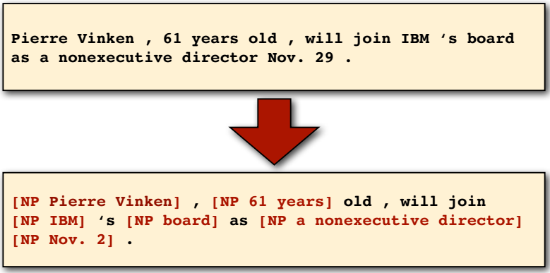
Noun phrase (NP) chunking
Task: identify all non-recursive NP chunks
Example credit for the this and next a few slides: Prof. Julia Hockenmaier

Slide 19
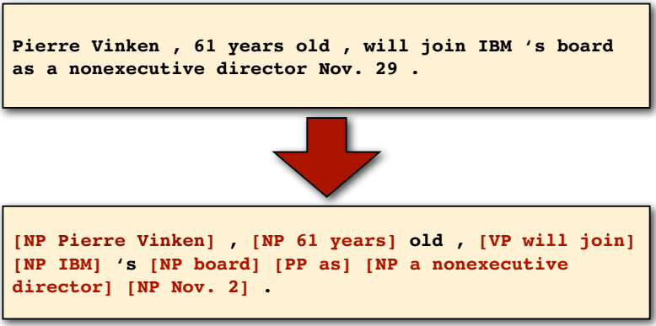
Shallow parsing
Task: identify all noun (“NP”), verb (“VP”) and preposition (“PP”) phrases.
Notes:
chunking

Slide 20
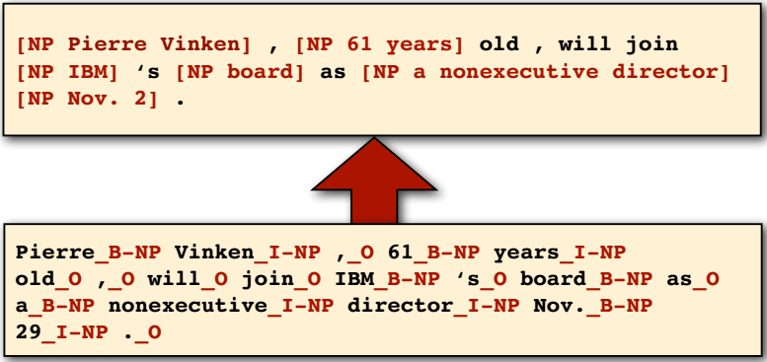
The BIO encoding
Define three new tags
B-NP: beginning of a noun phrase chunk
I-NP: inside of a noun phrase chunk
O: outside of a noun phrase chunk

Slide 21
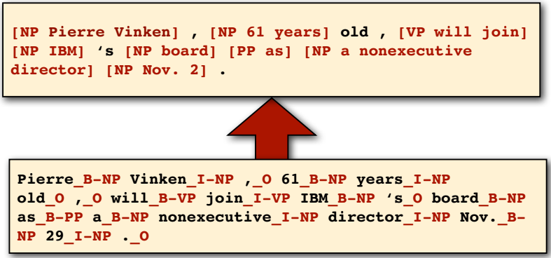
BIO Encoding for Shallow Parsing
Define new tags
B-NP B-VP B-PP: beginning of an “NP”, “VP”, “PP” chunk
I-NP I-VP I-PP: inside of an “NP”, “VP”, “PP” chunk
O: outside of any chunk

Slide 22
Problems with Sequence Labeling as Classification
Not easy to integrate information from category/tag of other tokens in the context.
Difficult to propagate uncertainty between decisions and “collectively” determine the most likely joint assignment of categories to all of the tokens in a sequence.
Time flies like an arrow.
NN VBZ IN DT NN
Fruit flies like a banana.
NN NN VBP DT NN

Slide 23
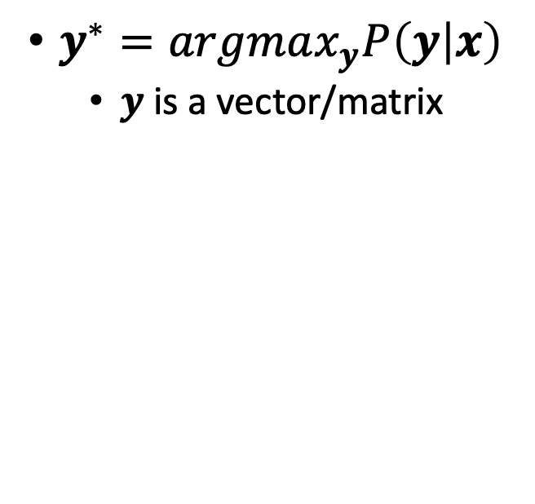
Sequential tagging v.s independent prediction
Sequence labeling
Independent classifiers
$y^{∗}=argmax_{y}P\left(y | x\right)$
$y$ is a vector/matrix
$y=argmax_{y}P(y|x)$
$y$ is a single label
y_{i}
y_{j}
y_{i}
y_{j}
x_{i}
x_{j}
x_{i}
x_{j}
Notes:
Sequential tagging problems model the dependencies between the *output* variables, which is different from *independent* classifiers that can leverage dependent input features (more concrete/intuitive examples later on).

Slide 24
Probabilistic Sequence Models
Probabilistic sequence models allow integrating uncertainty over multiple, interdependent classifications and collectively determine the most likely global assignment.
Three standard models
Hidden Markov Model (HMM)
Maximum Entropy Markov Models (MEMMs)
Conditional Random Field (CRF)

Slide 25
Hidden Markov Model (HMM)

Slide 26
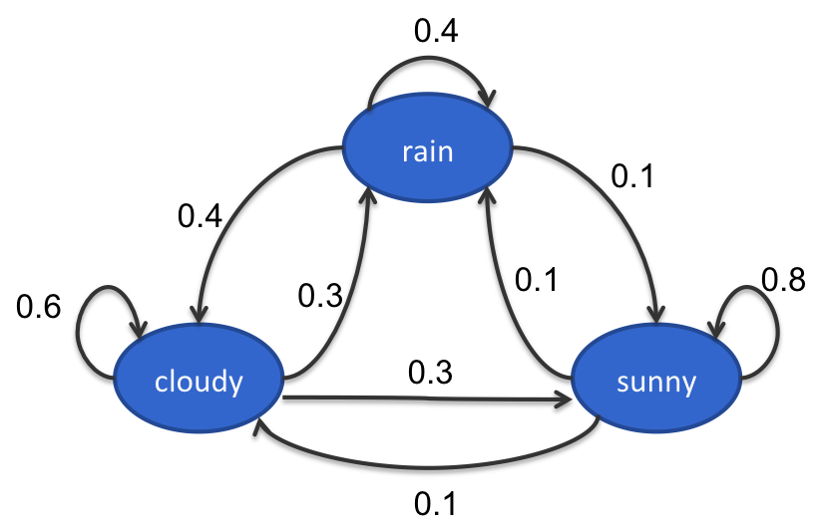
Hidden Markov Model
Hidden Markov Model:
A generative model that assumes the observations are generated from hidden states.
States follow a Markov chain
States are not observed
Each state stochastically emits an observation
0.2
0.4
0.1
0.7
0.4
0.2
1 ice cream
2 ice creams
3 ice creams
Notes:
State follow a markov chain: i.e., makes first order Markov assumption (more next slide).

Slide 27
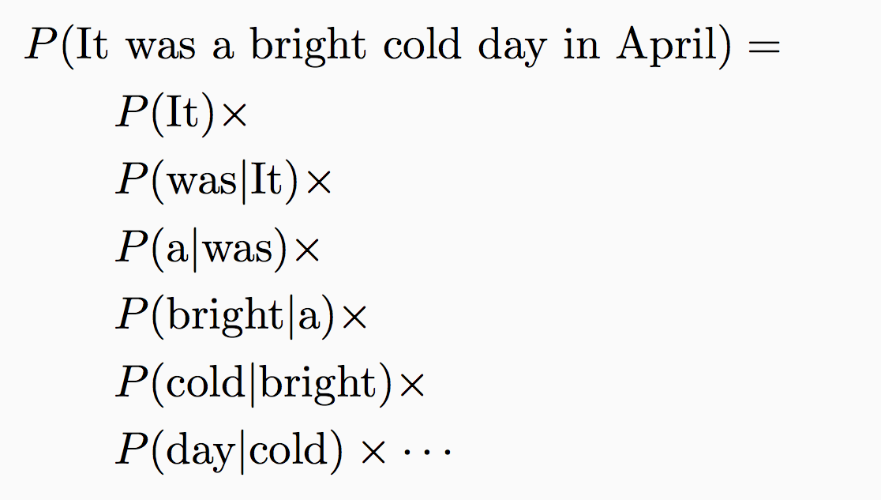
An Example of Markov Assumption
Bigram language model:
Probability of a word starting a sentence
Probability of a word following “It”
Probability of a word following “was”
Probability of a word following “a”

Slide 28
Toy part-of-speech example
The Fed raises interest rates
Transitions
Emissions
P(The | Determiner) = 0.5
P(A | Determiner) = 0.3
P(An | Determiner) = 0.1
P(Fed | Determiner) = 0
…
P(Fed| Noun) = 0.001
P(raises| Noun) = 0.04
P(interest| Noun) = 0.07
P(The| Noun) = 0
…
Determiner
Noun
Verb
start
Determiner
Noun
Verb
Noun
Noun
Initial
The
Fed
raises
interest
rates

Slide 29
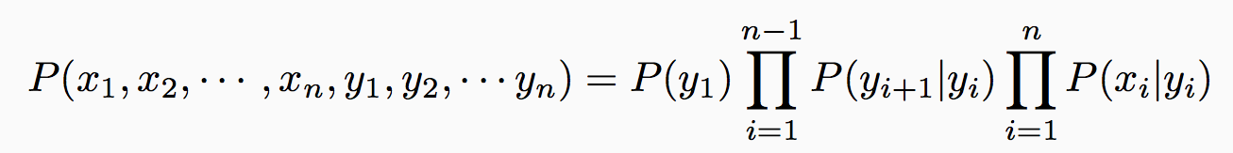
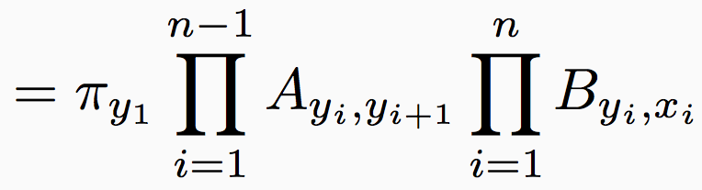
Joint model over states and observations
Notation
Number of states = K, Number of observations = M
π: Initial probability over states (K dimensional vector)
A: Transition probabilities (K×K matrix)
B: Emission probabilities (K×M matrix)
Joint probability of states and observations
Denote states by y₁, y₂, ☹ and observations by x₁, x₂, ☹
Notes:
Unique states and unique observations.

Slide 30
Three questions for HMMs
[Rabiner 1999]
Given an observation sequence, x₁, x₂, ☹ x_{n} and a model (π, A, B), how to efficiently calculate the probability of the observation?
Given an observation sequence, x₁, x₂, ☹, x_{n} and a model (π, A, B), how to efficiently calculate the most probable state sequence?
Unlike most classification problems, the inference problem for sequence tagging is non-trivial!
How to calculate (π, A, B) from observations?
Inference
Learning
Notes:
We focus on inference this lecture. will show examples to further demonstrate why it's non-trivial.

Slide 31
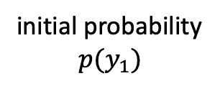
Prediction in generative model
Inference: What is the most likely sequence of tags for the given sequence of words x
What are the latent states that most likely generate the sequence of word x
P ( y_{i} | y_{i-1} )
y₁
y₂
y₂
y₄
P ( x_{i} | y_{i} )
initial probability
$$p(y_{1})$$
x₁
x₂
x₂
x₄

Slide 32
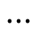
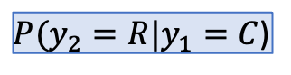
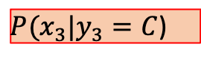
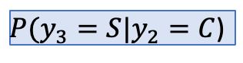
Inference: Trellis diagram
$P(y_{2}=R|y_{1}=C$)
$P(x_{3}|y_{3}=C$)
$P(y_{3}=S|y_{2}=C$)
C
C
C
C
R
R
R
R
$$⋯$$
0.2
0.4
0.1
0.7
0.4
0.2
S
S
S
S
1 ice cream
2 ice creams
3 ice creams
32
$$i=1 i=2 i=3 i=4$$
Notes:
We can unroll the compact representation into a trellis diagram for inference, where the diagram represents the hidden states at each time step. Edges represent transition probability and nodes represent emission probability (with observations of x).

Slide 33
Ice cream example
Best tag sequence for P(”1,2,3”)?
#cones
0.5
0.4
0.1
C
0.7
C
0.7
C
0.5
0.3
0.3
0.3
0.3
0.5
H
H
H
0.1
0.7
0.2
0.7
0.7
Notes:
Fill out the probability for the trellis diagram.
Best sequence: CCH ==> how do you know?

Slide 34
Toy part-of-speech example
The Fed raises interest rates
Transitions
Emissions
P(The | Determiner) = 0.5
P(A | Determiner) = 0.3
P(An | Determiner) = 0.1
P(Fed | Determiner) = 0
…
P(Fed| Noun) = 0.001
P(raises| Noun) = 0.04
P(interest| Noun) = 0.07
P(The| Noun) = 0
…
P(Fed| Verb) = 0.1
P(raises| Verb) = 0.15
P(interest| Verb) = 0.02
P(The| Verb) = 0
…
Determiner
Noun
Verb
0.5
0.0
0.0
D
D
D
0.04
…
0.0
0.001
N
N
N
…
V
V
V
0.0
0.1
0.15

Slide 35
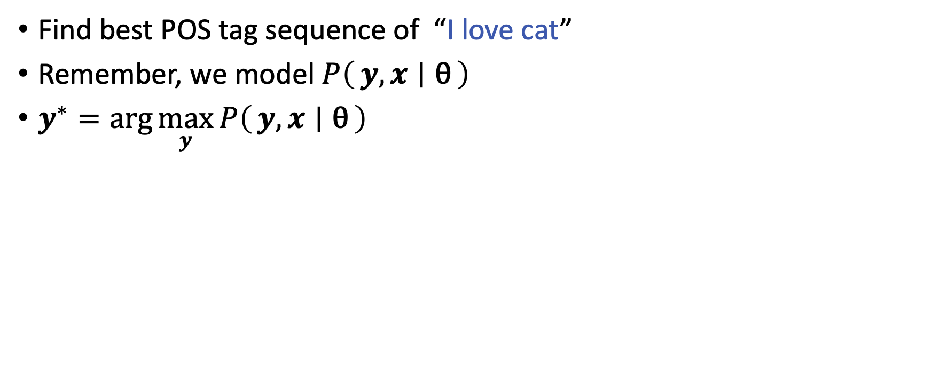
Tagging the input
Find best POS tag sequence of “I love cat”
Remember, we model $P\left(y,x ∣ \text{θ}\right)$
$y^{∗}=\arg{\max_{y}{P\left(y, x ∣ \text{θ}\right)}}$
Find the best one from all possible tag sequences

Slide 36
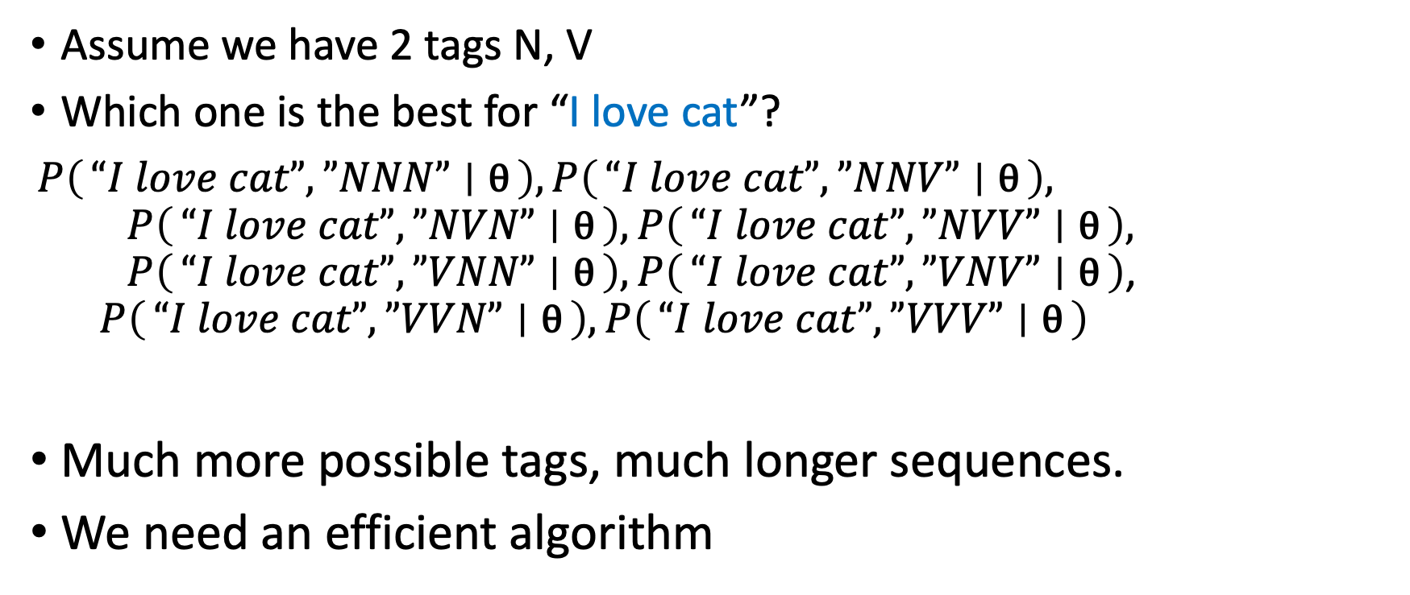
Tagging the input
Assume we have 2 tags N, V
Which one is the best for “I love cat”?
$P\left(“I love cat”,”NNN” ∣ \text{θ}\right), P\left(“I love cat”,”NNV” ∣ \text{θ}\right),$ $P\left(“I love cat”,”NVN” ∣ \text{θ}\right), P\left(“I love cat”,”NVV” ∣ \text{θ}\right),$ $P\left(“I love cat”,”VNN” ∣ \text{θ}\right),P\left(“I love cat”,”VNV” ∣ \text{θ}\right)$, $P\left(“I love cat”,”VVN” ∣ \text{θ}\right),P\left(“I love cat”,”VVV” ∣ \text{θ}\right)$
Much more possible tags, much longer sequences.
We need an efficient algorithm
Notes:
What’s the complexity for the problem with k possible tags, and n sequence length?
Exponential search space -- need efficient algorithm.

Slide 37
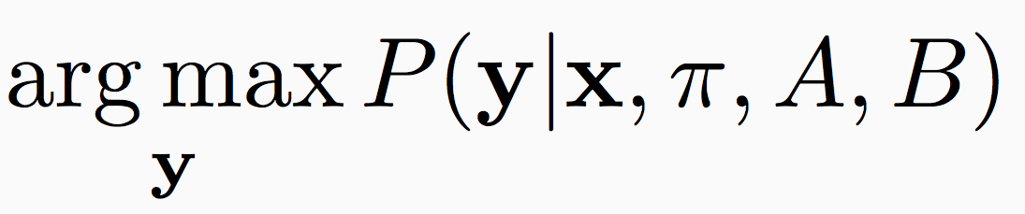
Most likely state sequence
Input:
A hidden Markov model (π, A, B)
An observation sequence x = (x₁, x₂, ☹, x_{n})
Output: A state sequence y = (y₁, y₂, ☹, y_{n}) that corresponds to
Maximum a posteriori inference (MAP inference)
Computationally: combinatorial optimization
Viterbi Algorithm
Notes:
Note: the inference problem assume the model has already been learned/trained.

Slide 38
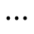
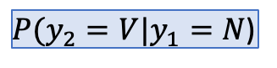
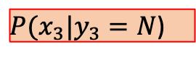
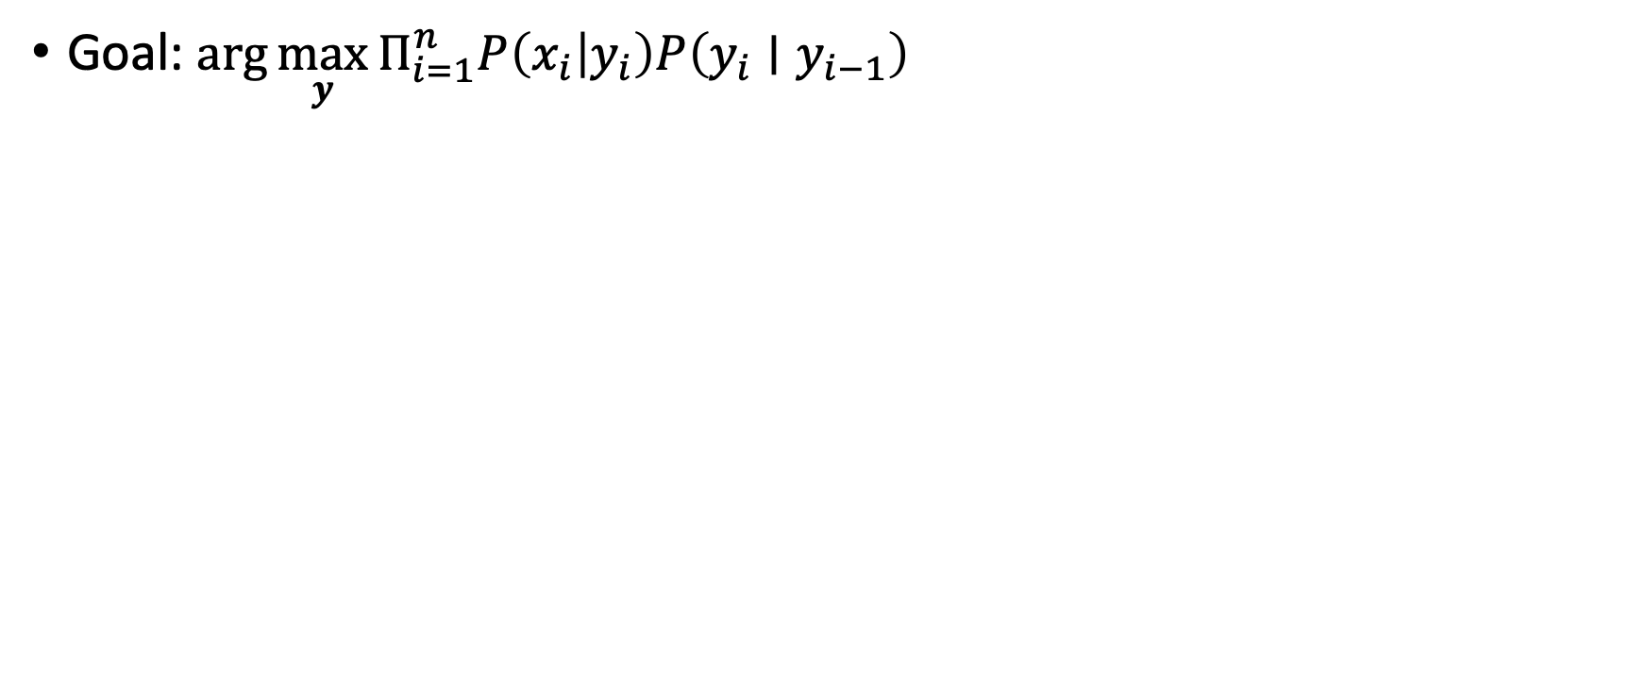
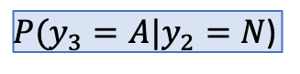
Trellis diagram
Goal: $\arg{\max_{y}{Π_{i=1}^{n}P\left(x_{i} | y_{i}\right)P\left(y_{i}∣y_{i−1}\right)}}$
$P(y_{2}=V|y_{1}=N$)
$P(x_{3}|y_{3}=N$)
$P(y_{3}=A|y_{2}=N$)
N
N
N
N
C
C
C
C
V
V
V
V
R
R
R
R
$$⋯$$
A
A
A
A
S
S
S
S
$$i=1 i=2 i=3 i=4$$

Slide 39
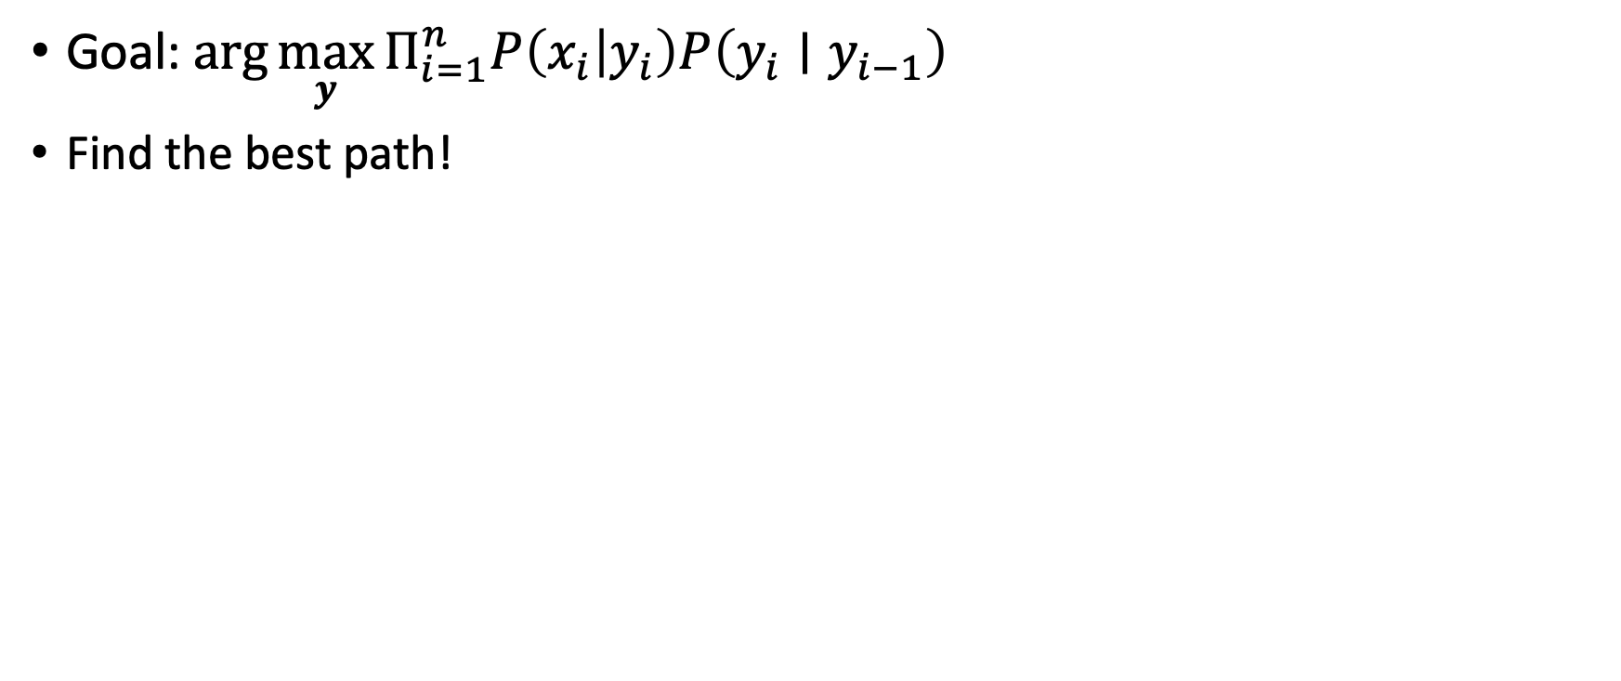
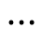
Trellis diagram
Goal:$\arg{\max_{y}{Π_{i=1}^{n}P\left(x_{i} | y_{i}\right)P\left(y_{i}∣y_{i−1}\right)}}$
Find the best path!
N
N
N
N
V
V
V
V
$$⋯$$
A
A
A
A
$$i=1 i=2 i=3 i=4$$
Notes:
Red highlights denote "paths".

Slide 40
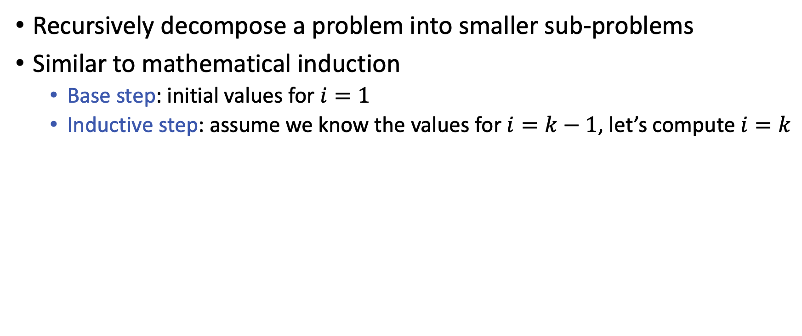
Dynamic programming!
Recursively decompose a problem into smaller sub-problems
Similar to mathematical induction
Base step: initial values for $i=1$
Inductive step: assume we know the values for $i=k−1$, let’s compute $i=k$

Slide 41
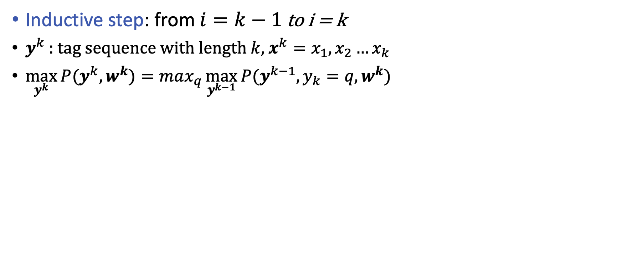
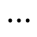
Viterbi algorithm
Inductive step: from $i=k−1$ to i = k
$y^{k}$ : tag sequence with length $k$, $x^{k}=x_{1},x_{2}…x_{k}$
$\max_{y^{k}}{P(y^{k}, w^{k})}=max_{q}{\max_{y^{k−1}}{P(y^{k−1}, y_{k}=q, w^{k})}}$
tag sequences until step k-1
tag @ i=k
tag sequences until step k
N
N
N
N
V
V
V
V
$$⋯$$
A
A
A
A
$$i=1 i=2 i=3 i=4$$
Notes:
Assume we end with state q, how to find the best previous state the lead to the current state?

Slide 42
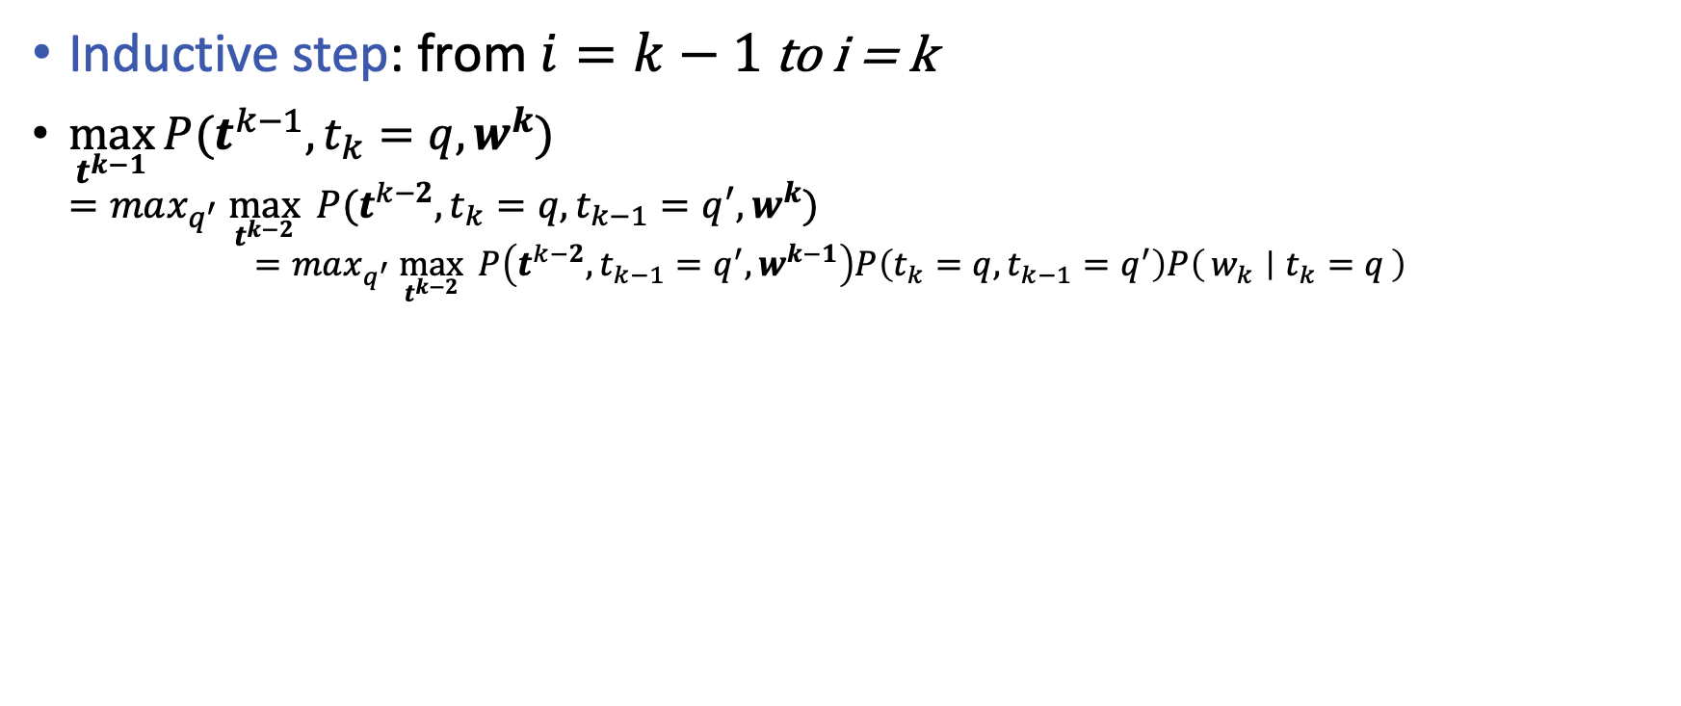
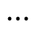
Viterbi algorithm
Let’s call it $δ_{k}(q)$
Inductive step: from $i=k−1$ to i = k
$\max_{t^{k−1}}{P(t^{k−1}, t_{k}=q, w^{k})}$ $=max_{q^{′}} \max_{t^{k−2}}{ P(t^{k−2}, t_{k}=q, t_{k−1}=q^{′}, w^{k})}$ $=max_{q^{′}} \max_{t^{k−2}}{ P\left(t^{k−2}, t_{k−1}=q^{′}, w^{k−1}\right)P\left(t_{k}=q, t_{k−1}=q^{′}\right)P\left(w_{k} ∣ t_{k}=q\right)}$
This is $δ_{k−1}(q′)$
N
N
N
N
V
V
V
V
$$⋯$$
A
A
A
A
$i=k−1 i=k$
Notes:
We define a unit step as "the best sequence ending with state q" (in our context, ending with a particular POS tag such as Noun).
We can further decompose this as "find the best immediate previous state q' that result in the highest probability ending with state q." and derive the inductive step.

Slide 43
Viterbi algorithm
Inductive step: from $i=k−1$ to i = k
$δ_{k}\left(q\right)\text{=}\max_{q′}{δ_{k−1}(q^{′})}P({t_{k}=q∣t}_{k−1}=q′)P({w_{k}∣t}_{k}=q)$
N
N
N
N
V
V
V
V
$$⋯$$
A
A
A
A
$i=k−1 i=k$
Notes:
rewrite the previous page's equation into the \delta representation.

Slide 44
Viterbi algorithm
Inductive step: from $i=k−1$ to i = k
$δ_{k}\left(q\right)\text{=}\max_{q^{′}}{δ_{k−1}\left(q^{′}\right)}P\left({t_{k}=q∣t}_{k−1}=q^{′}\right)P\left({w_{k}∣t}_{k}=q\right)$ $\text{=}P\left({w_{k}∣t}_{k}=q\right){\max_{q^{′}}{δ_{k−1}\left(q^{′}\right)}}P\left({t_{k}=q∣t}_{k−1}=q^{′}\right)$
N
N
N
N
V
V
V
V
$$⋯$$
A
A
A
A
$i=k−1 i=k$
Notes:
Rearrange since p(w_k | t_k=q) does not rely on the previous state q'.

Slide 45
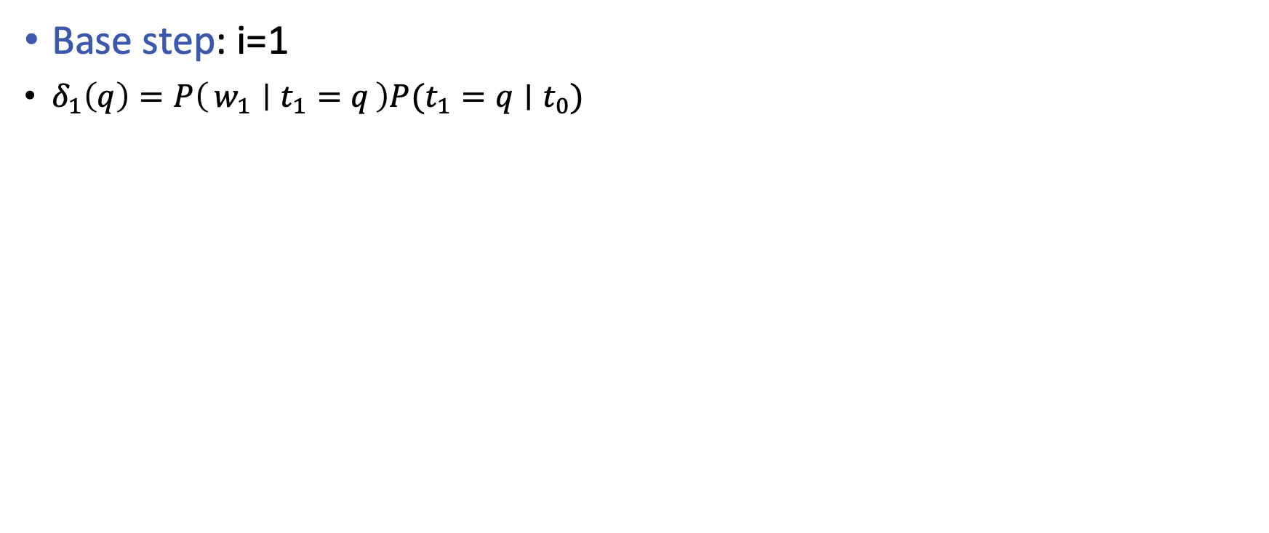
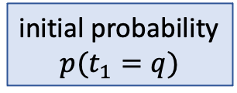
Viterbi algorithm
Base step: i=1
$δ_{1}\left(q\right)=P\left(w_{1} ∣ t_{1}=q\right)P(t_{1}=q∣t_{0})$
initial probability
$$p(t_{1}=q)$$
N
N
N
N
V
V
V
V
$$⋯$$
A
A
A
A
$i=k−1 i=k$

Slide 46
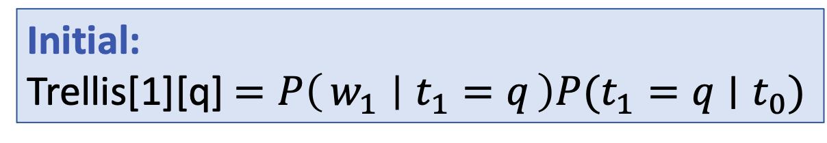
Implementation using an array
Initial:
Trellis[1][q] $=P\left(w_{1} ∣ t_{1}=q\right)P(t_{1}=q∣t_{0})$
Notes:
The viterbi inference algorithm can be conveniently implemented in an array data structure.
how many rows and how many columns?

Slide 47
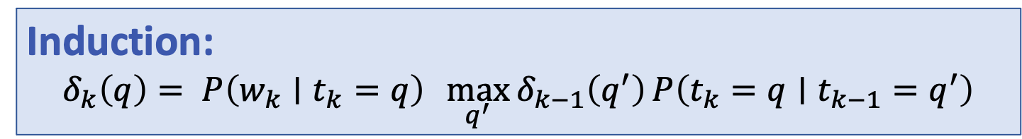
Implementation using an array
Induction:
$$δ_{k}\left(q\right)= P\left({w_{k}∣t}_{k}=q\right){\max_{q^{′}}{δ_{k−1}\left(q^{′}\right)}}P\left({t_{k}=q∣t}_{k−1}=q^{′}\right)$$
Notes:
Each cell in this array represent \delta_k(q): at step k, the probability of being state q.

Slide 48
Retrieving the best sequence
Keep one backpointer
best

Slide 49
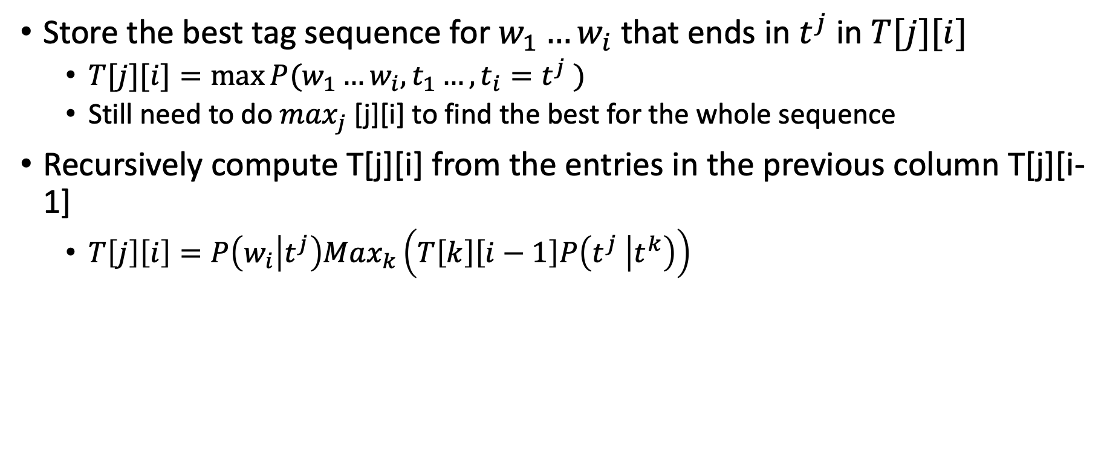
Viterbi algorithm
Store the best tag sequence for $w_{1}…w_{i}$that ends in $t^{j}$ in $T[j][i]$
$T[j][i]=max⁡P(w_{1}…w_{i}, t_{1}…, t_{i}=t^{j} )$
Still need to do $\max_{j}$ [j][i] to find the best for the whole sequence
Recursively compute T[j][i] from the entries in the previous column T[j][i-1]
$T\left[j\right]\left[i\right]=P\left(w_{i} | t^{j}\right)Max_{k}\left(T\left[k\right]\left[i−1\right]P\left(t^{j} | t^{k}\right)\right)$
Generating the current observation
Transition from the previous best ending tag
The best i-1 tag sequence
Notes:
update references for RNNs on the course website

Slide 50
Sequence Labeling Makes A Difference
Comparing sequence labeling with classification for the two examples
The
robot
wheels
are
round
The
robot
wheels
Bill
round
0.7
0.9
0.6
0.7
0.2
0.6
0.4
0.1
0.4
0.1
N
V
A
N
V
A
0.5
0.6
0.1
0.1
0.1
0.1
1
D
1
N
D
N
0.5
0.8
0.5
0.8
0.4
V
N
N
0.4
V
N
N
0.8
0.5
0.8
0.5
0.3
0.1
0.4
0.3
0.8
0.4
Notes:
If take individual classification approach, the best sequence for the two sentences would be:
With sequence labeling, it would be:
Why?
This also shows why the inference problem is non-trivial.

Slide 51
Applications of HMMs
NLP applications
POS tagging
NP chunking
Shallow parsing
Named Entity Recognition
Machine Translation
Aside from all sequence labeling problems in NLP
Computational finance
Transportation forecasting
Time series analysis

Slide 52
Next time
Learning HMM Model parameters
Generative model vs. discriminative model
Maximum Entropy Markov Model (MEMM)

